Slide 1
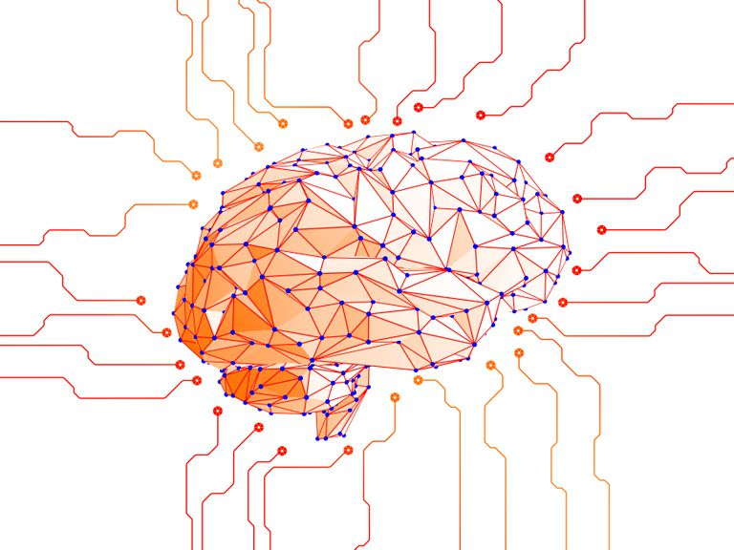
Artificial Neural Networks
PhD. Msc. David C. Baldears S.
PhD(s) Msc. Diego Lopez-Bernal
https://www.lifewire.com/neural-networks-4155332

Slide 2
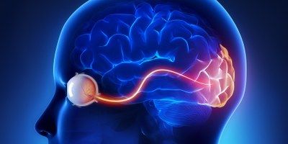
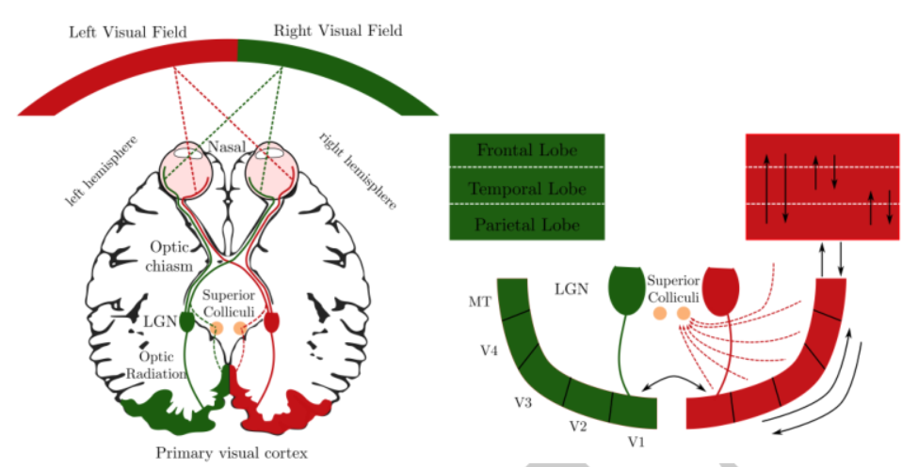
Brain Neural Network
The main part of the brain is its depth
It uses multiple layers to make a decision
For instance the visual system has many layers to detect objects and movement

Slide 3
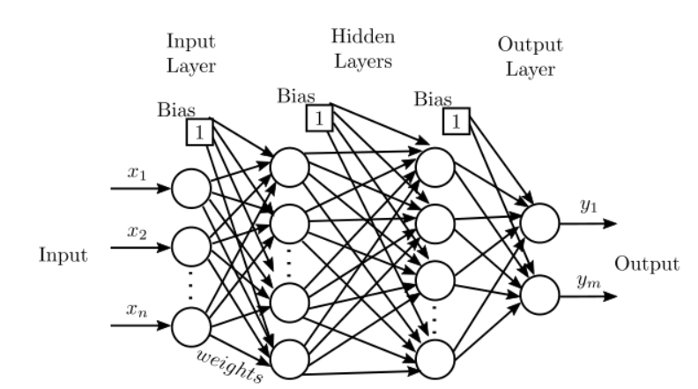
Artificial Neural Network
It is a network with multiple layers. Hence, it requires to train layer by layer
1969 Bryson and Ho invented Backpropagation to train a multilayer network
Backpropagation is a sensible approach for dividing the contribution of each weight
Basically it works similarly to perceptrons

Slide 4
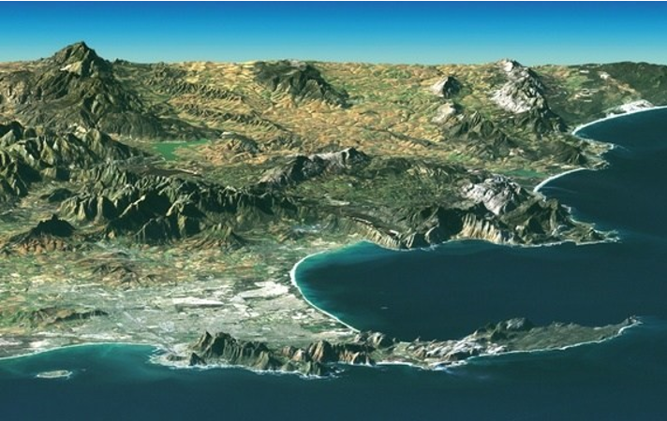
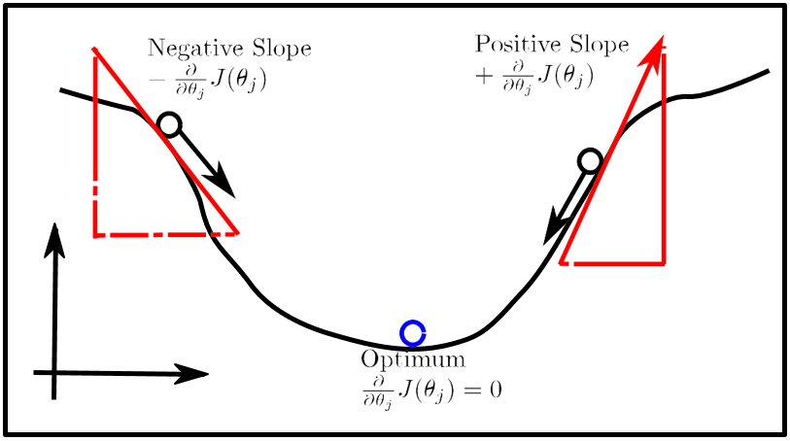
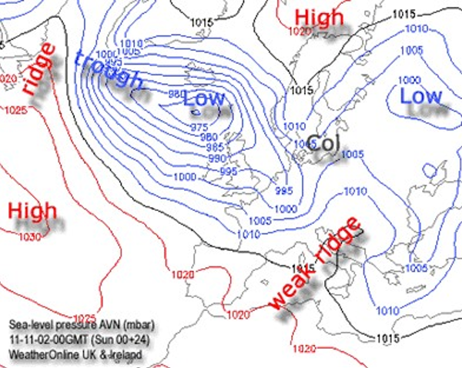
Gradient Descent
Its an observation that a function decreases the negative direction of the slope
This has to be adapt accordingly

Slide 5
Gradient Descent
The direction of steepest descent is given by the negative of the gradient.
A rough idea how to minimize J:
Start with random values for W and b
Compute the gradients of J with respect to W and b
Take a small step along the direction of the negative gradient
Go back to 2

Slide 6
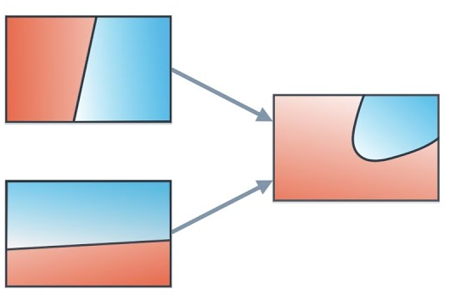
Why ANN?
So why do we need so many neurons in an ANN if one will suffice?
Well, individual neurons are unable to classify non-linearly separable data because they can only ever learn a linear decision boundary.
However, by combining neurons together, essentially, they combine their decision boundaries. Therefore, an ANN composed of many neurons is able to learn non-linear decision boundaries.

Slide 7
Training
Question 1: When can we compute the gradients of the parameters of an arbitrary neural network?
Question 2: When can we make the gradient computation efficient?

Slide 8
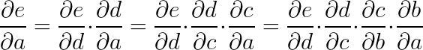
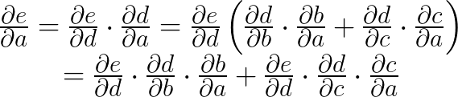
Chain Rule
Based on Gradient Descent and chain rule
For instance, the following computational graph: by the chain rule
Similarly in the following scenario: In this case a contributes to e along two paths: The path a, b, d, e and the path a, b, c, e. Hence, the total derivative of e with respect to a is given by:
b
a
d
e
a
b
c
d
e
c
https://www.codingame.com/playgrounds/9487/deep-learning-from-scratch---theory-and-implementation/gradient-descent-and-backpropagation
Notes:
\frac{\partial e}{\partial a} = \frac{\partial e}{\partial d}\cdot \frac{\partial d}{\partial a} = \frac{\partial e}{\partial d} \cdot \frac{\partial d}{\partial c} \cdot \frac{\partial c}{\partial a} = \frac{\partial e}{\partial d} \cdot \frac{\partial d}{\partial c} \cdot \frac{\partial c}{\partial b} \cdot \frac{\partial b}{\partial a}

Slide 9
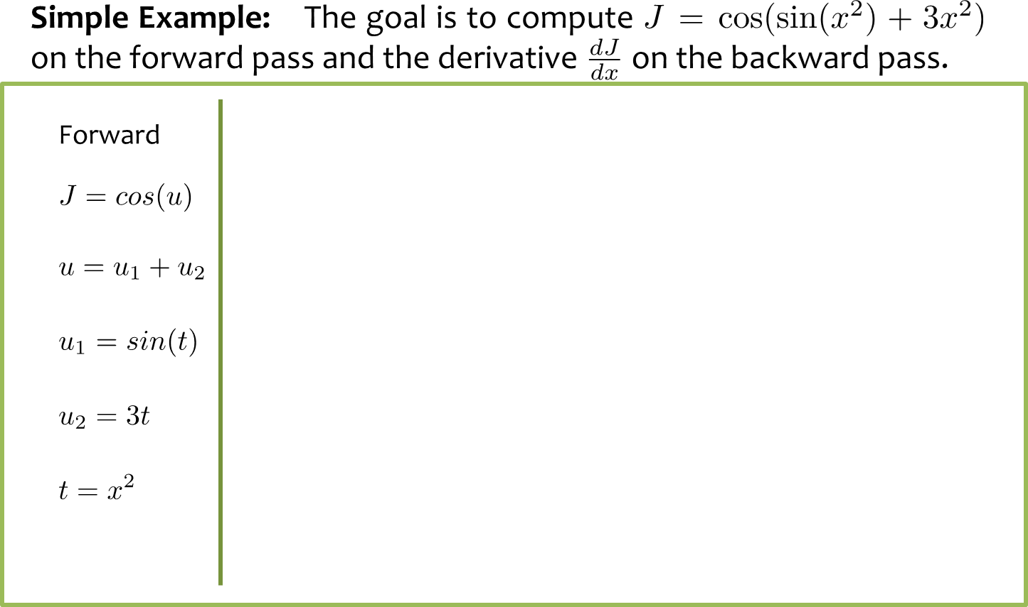
Chain Rule

Slide 10
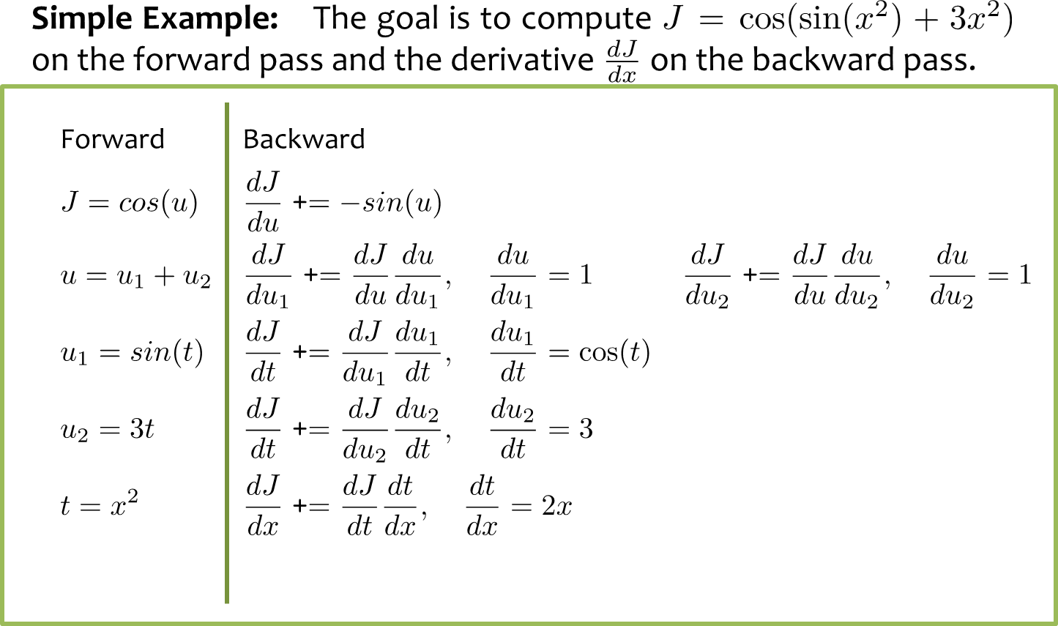
Chain Rule

Slide 11
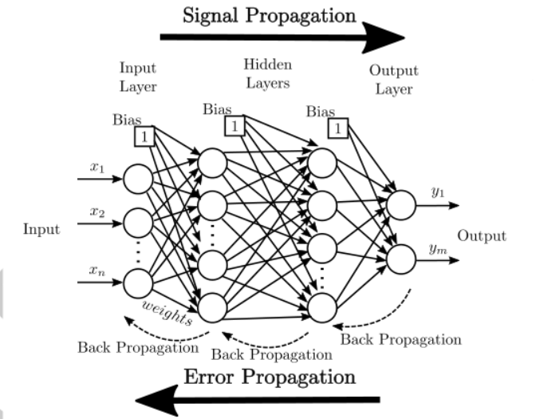
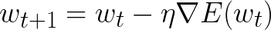
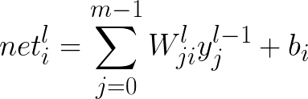
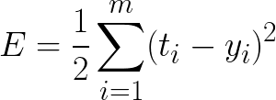
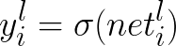
Backpropagation
The Weights need to be corrected according to the gradient of the error caused by those weights Forward Propagation For all neurons in the layer multiply their corresponding weights times the input and add the bias Calculate if the neuron activates or not (activation function)
Repeat for all layers until you reach the output
Calculate the error from the real target and the network output
Notes:
E = \frac{1}{2}\sum\limits_{i = 1}^{m} (t_i - y_i)^2

Slide 12
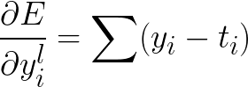
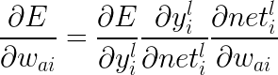
Backpropagation
Using the error the partial with respect to output can be calculated (check summation sign) Last Layer According to the last layer the error has to be propagated to adapt the weights (applying the chain rule twice)
Notes:
\frac{\partial E}{\partial y_{i}^l} = \sum (y_i-t_i)
\frac{\partial E}{\partial w_{ai}} = \frac{\partial E}{\partial y_{i}^l} \frac{\partial y_{i}^l}{\partial net_{i}^l} \frac{\partial net_{i}^l}{\partial w_{ai}} = \sum (y_i-t_i)\sigma'(net_i^l)y_i^{l-1}

Slide 13
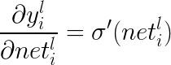
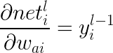
Backpropagation
Each term The first term: Remember
hence, the second term:
Also , then
Notes:
\frac{\partial E}{\partial y_{i}^l} = \sum (y_i-t_i)

Slide 14
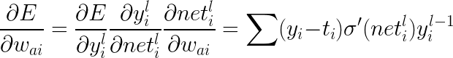
Backpropagation
As a result
Notes:
\frac{\partial E}{\partial y_{i}^l} = \sum (y_i-t_i)

Slide 15
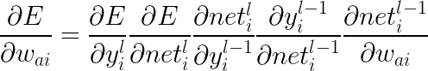
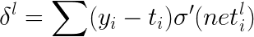
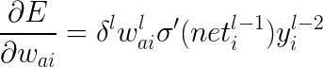
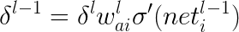
Backpropagation
For an interior neuron delta of error which results in Note that a new delta can be calculated for next layer:
Notes:
\frac{\partial E}{\partial w_{ai}} = \frac{\partial E}{\partial y_{i}^l} \frac{\partial E}{\partial net_{i}^l} \frac{\partial net_{i}^l}{\partial y_{i}^{l-1}} \frac{\partial y_{i}^{l-1}}{\partial net_{i}^{l-1}} \frac{\partial net_{i}^{l-1}}{\partial w_{ai}}
\frac{\partial E}{\partial w_{ai}} = \delta^l w_{ai}^l\sigma'(net_i^{l-1}) y_{i}^{l-2}
\delta^{l-1} = \delta^l w_{ai}^l\sigma'(net_i^{l-1})

Slide 16
Backpropagation
Algorithm Artificial Neural Network trained with Back-Propagation
Input Network: Labeled dataset D labeled and positive parameters η,µ
Repeat
Forward Propagation:
for All Layers do
Calculate activation: y_{l}= σ(W_{ji}*y_{l−1}+ b_{i})
endfor
Calculate quadratic error: E =½(t_{i} − y_{i})²
Backward Propagation:
Obtain first delta δ=(y_{i}−t_{i})σ’(net)
for All Layers do:
Calculate Gradient: ∇E(w ai ) = δ_{l}w_{l}σ’(net_{l−1})y_{l−2}
New delta: δ_{l−1} =δ_{l}w_{l}σ’(net_{l−1})
end for
Update weights
∆w t = µ∆w_{t−1}
w_{t+1} = w_{t} + ∆w_{t} ,
until w ij when it converges

Slide 17
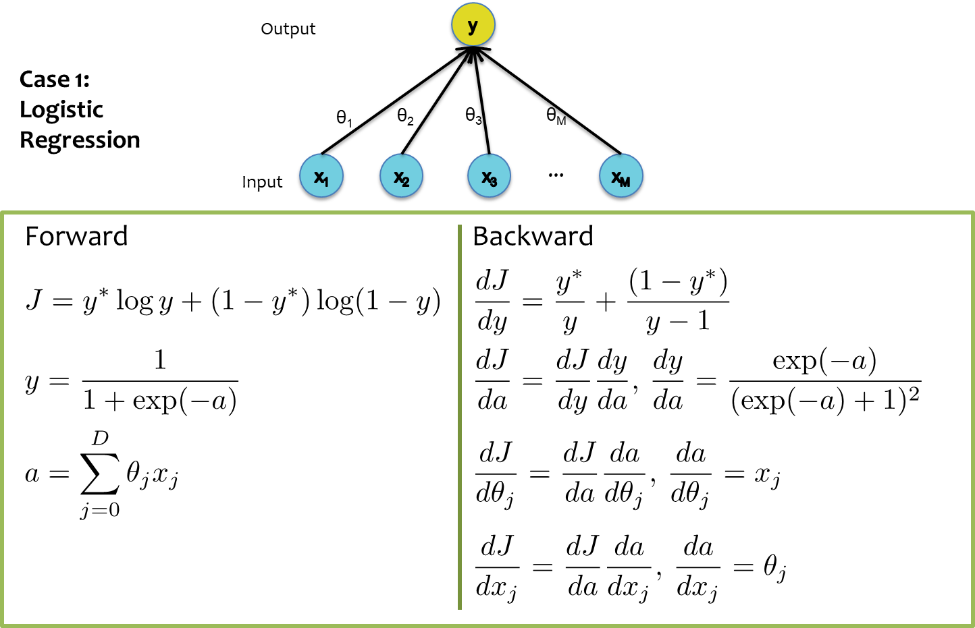
Backpropagation

Slide 18
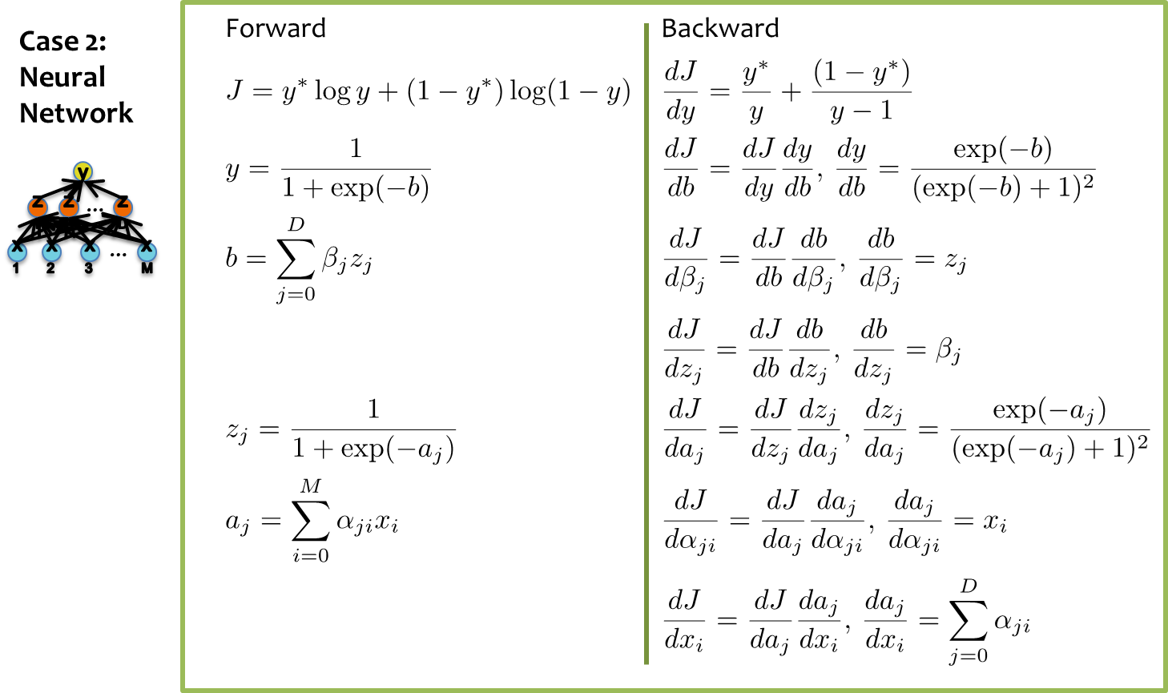
Backpropagation

Slide 19
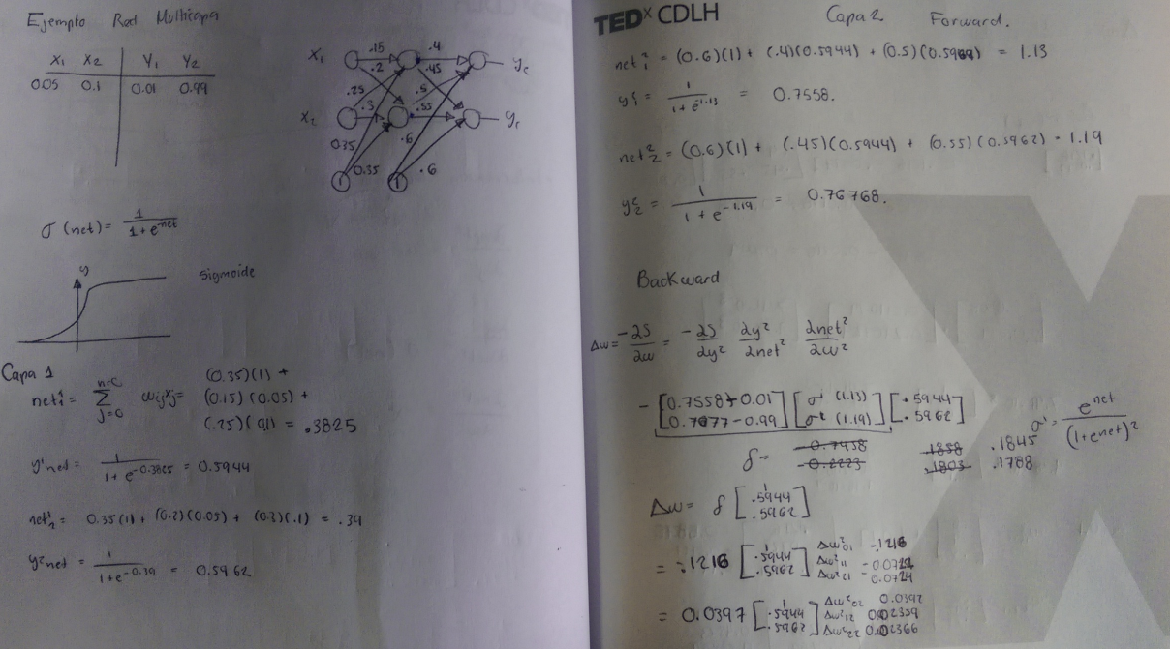
Example

Slide 20
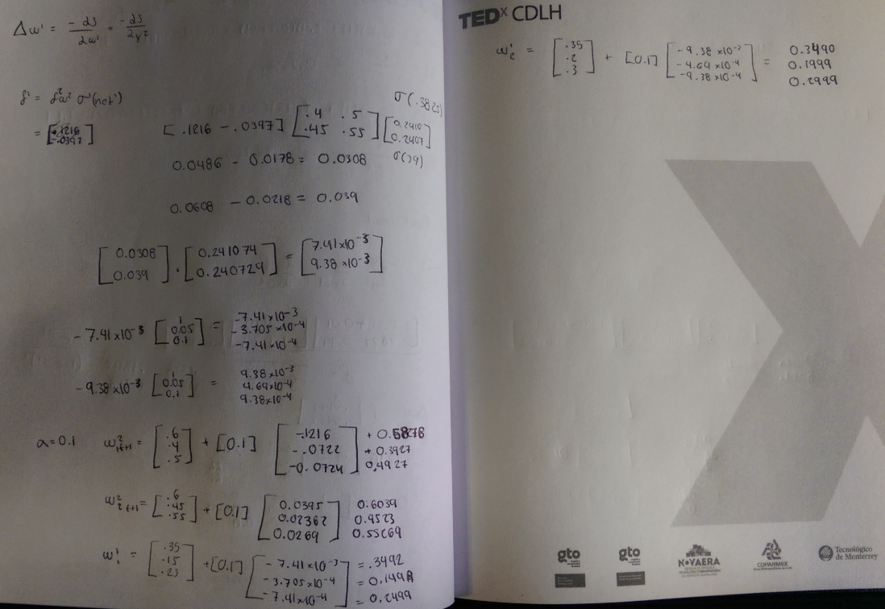
Example - Cont

Slide 21
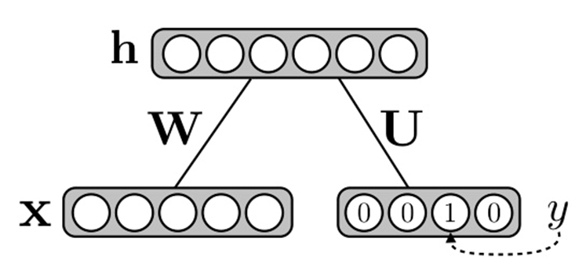
Restricted Boltzmann Machines
Generative Stochastic Artificial Neural Network
Creates an internal representation over the inputs

Slide 22
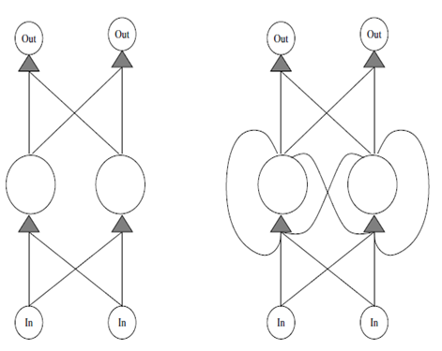
Recurrent Neural Networks
RNNs have cyclic connections making them powerful for modeling sequences.

Slide 23
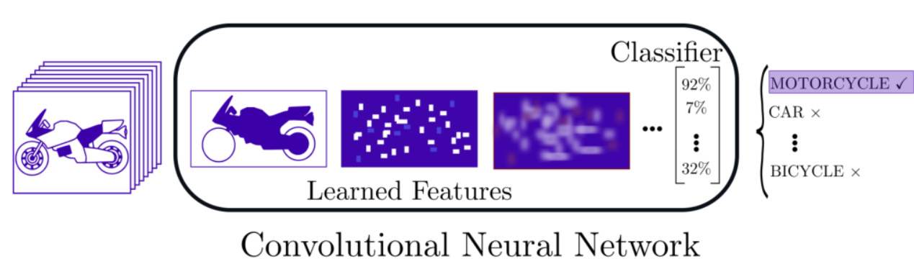
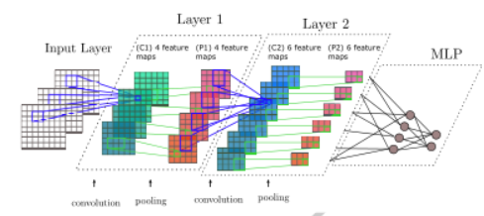
Convolutional Neural Networks
Based on several filters it decompose the image until it reaches small features that easy to discriminate

Slide 24
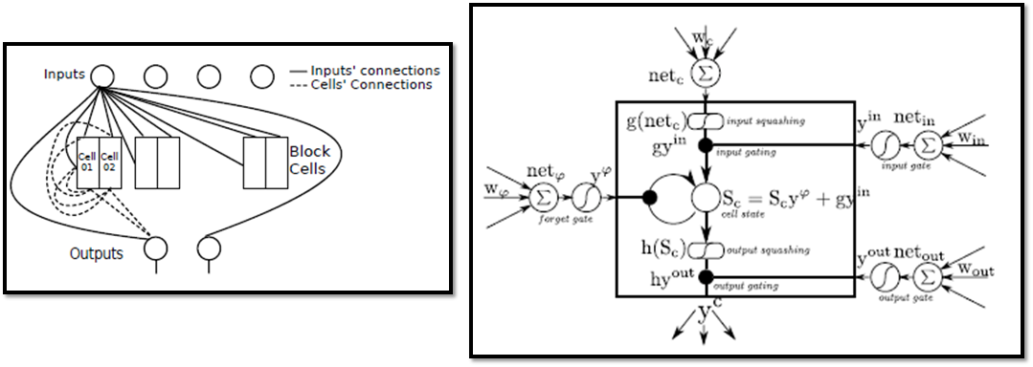
Long Short Term Memory
Recurrent Network
Uses gates to keep information

Slide 25
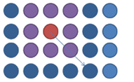
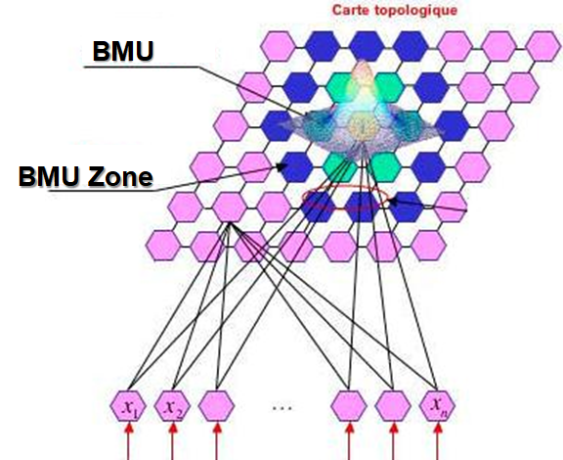
Self Organizing Map (SOM)
Supervised
Generates the class without teaching it
Vectorize the information

Slide 26
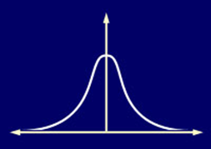
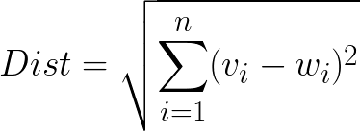
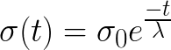
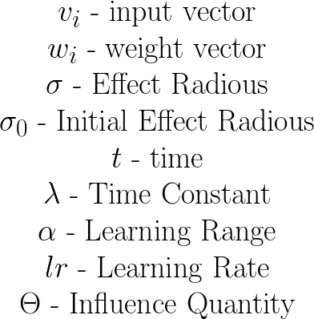
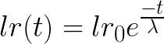
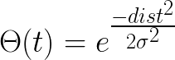
SOM
The one with the shortest distance is selected
The affectation distance is updated
The learning rate is updated
The weights are updated
Notes:
Dist = \sqrt{ \sum_{i = 1}^n (v_i-w_i)^2 }
\sigma (t) = \sigma_0 e^{\frac{-t}{\lambda}}
lr (t) = lr_0 e^{\frac{-t}{\lambda}}
\Theta (t) = e^{\frac{-dist^2}{2\sigma^2}}
w(t+1) = w(t) + \alpha \Theta lr(v_i - w_i)
\begin{matrix}
v_i\text{ - input vector}\\
w_i\text{ - weight vector}\\
\sigma \text{ - Effect Radious}\\
\sigma_0\text{ - Initial Effect Radious}\\
t\text{ - time}\\
\lambda \text{ - Time Constant}\\
\alpha \text{ - Learning Range}\\
lr \text{ - Learning Rate}\\
\Theta \text{ - Influence Quantity}\\
\end{matrix}

Slide 27

https://www.researchgate.net/figure/The-different-types-of-neural-networks-source-http-www_fig9_323142453

Slide 28
Summary
Neural Networks…
provide a way of learning features
are highly nonlinear prediction functions
(can be) a highly parallel network of logistic regression classifiers
discover useful hidden representations of the input
Backpropagation…
provides an efficient way to compute gradients
is a special case of reverse-mode automatic differentiation

